Slide 1



Identify Local Popular Entertainment
with Yelp data
Yaofei Wang Zhuoyu Han wang.yaof@husky.neu.edu han.zhu@husky.neu.edu
EECE5642 -Data Visualization
2018.04.12

Slide 2
Outline
Background
Data Source
Data Analysis
Visualization
Challenges & Future work

Slide 3

Background
When travelling in another city—
best restaurant?
best gift shop?
best museum?
Anyway, the best place to have fun!

Slide 4
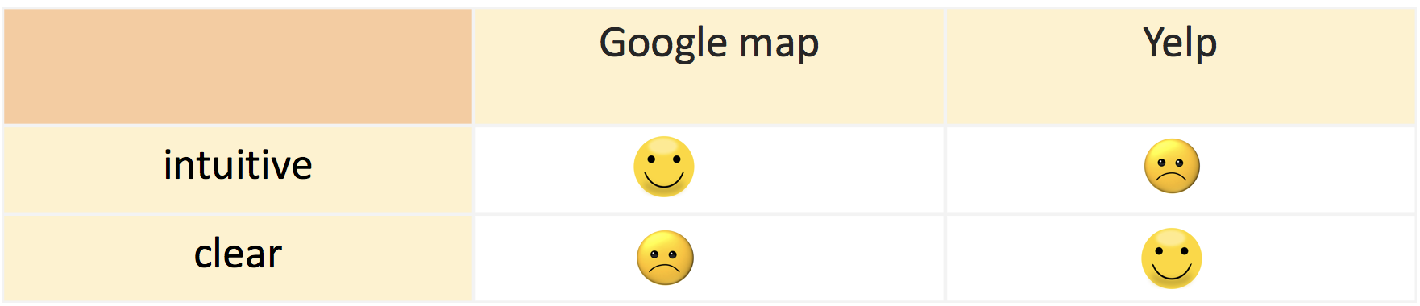

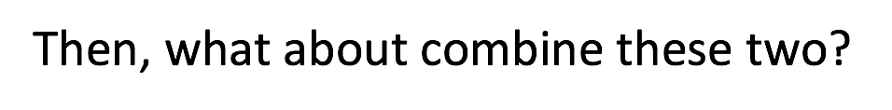

Outline

Slide 5
Data Source: Yelp Dataset
A trove of reviews, businesses, users, tips and check-in data
In total, there are:
5,200,000 user reviews
Information on 174,000 businesses
The data spans 11 metropolitan areas
Selected Features | Business ID, name, address, city, state, postal code , latitude , longitude, stars, review count
Target | categories
https://www.kaggle.com/yelp-dataset/yelp-dataset

Slide 6
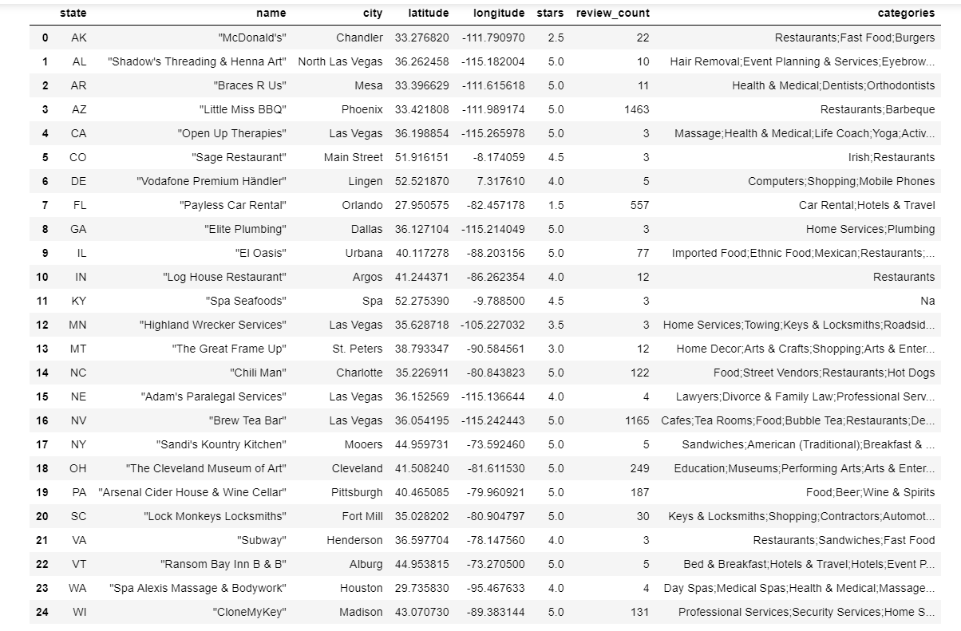
Data Analysis
Implemented by Python
Criterion:
Select business within U.S
One each state
Highest stars -> most customer reviews
Representative label for each category
Appropriate icon for each icon

Slide 7
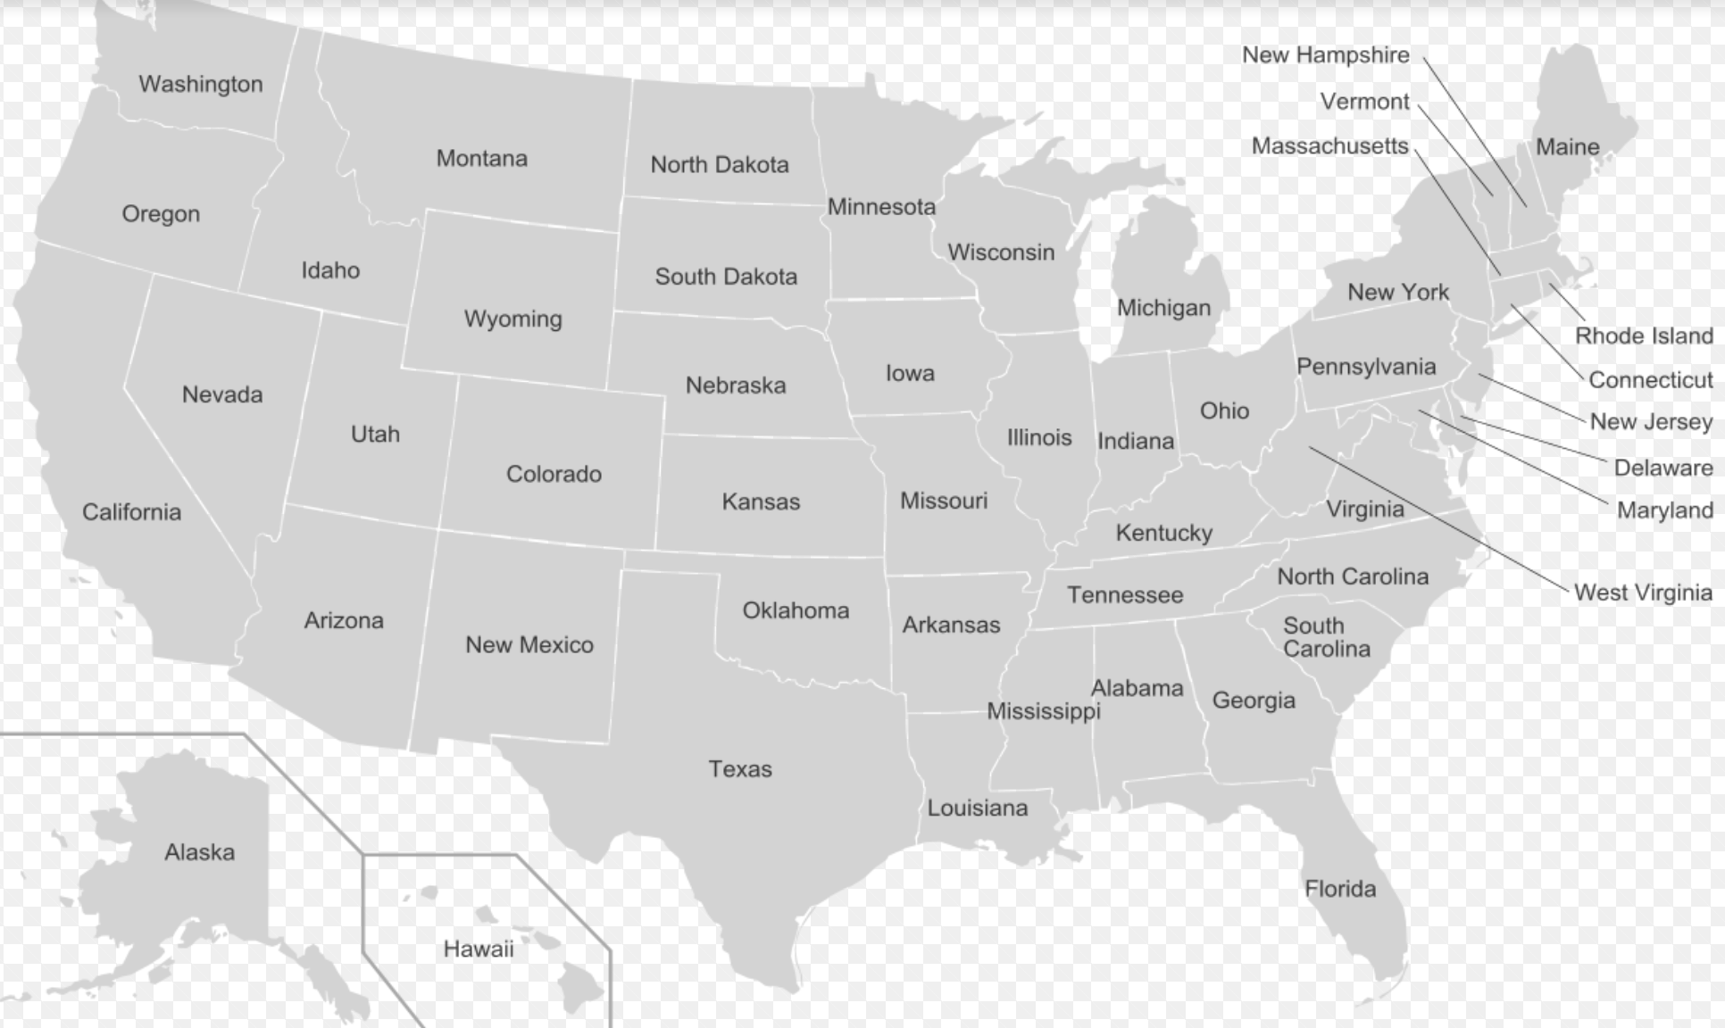


Visualization
Tools
HTML
CSS

Slide 8
Challenges & Future Work
Challenges | Future Work
Yelp dataset does not cover all states within U.S. Criterion of popularity is hard to determine. In visualization, information to show needs to be selected for efficiency. | Search for more data which convers whole U.S. or even extend to global. Combine stars and count of reviews by algorithms or machine learning model to obtain more objective result.

